Slide 1

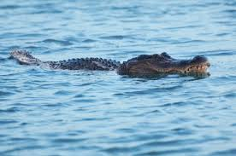
Presentation 2026
Modeling the Dietary Habits of Alligator
Investigating the impact of habitat and biological maturity on predatory behavior in Florida lakes
Presented by Priyansh Tyagi
202007480

Slide 2
The Biological Context
Alligators are opportunistic apex predators whose dietary habits fluctuate based on environmental availability and physiological growth . This study tracks the stomach contents of 219 alligators captured across four distinct Florida lakes:
George,
Hancock,
Oklawaha,
Trafford.
By analyzing these samples, we can determine how geographical habitat dictates prey selection and how biological maturity enables a transition to different dietary categories .
Presentation 2026
Research Variables
The primary response variable is Food Choice, categorized into five nominal levels: Fish (baseline), Invertebrates, Reptiles, Birds, and Other . To model these choices, we utilize two categorical predictors: Lake (location) and Size (maturity) . Size is bifurcated at the 2.3-meter threshold to distinguish between "Small" juveniles and "Large" adults, allowing us to quantify the "ontogenetic shift" in predatory behavior .
01

Slide 3
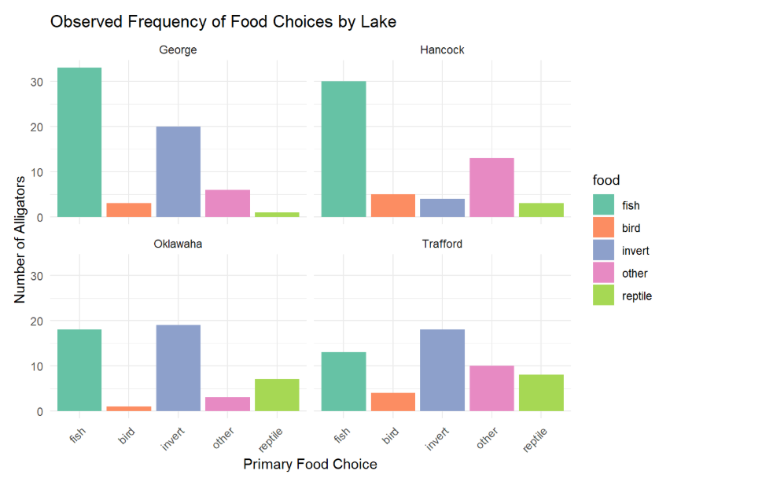
Exploratory Data Analysis (EDA)
Dominance of Fish: Fish is the most frequent dietary observation in Lake George and Lake Hancock. This widespread prevalence across the sample justifies its selection as the baseline reference category for the multinomial model.
Before fitting the multinomial model, we examine the raw distribution of food choices across the four Florida lakes. This initial visualization allows us to identify dietary patterns, justify the selection of our reference category, and acknowledge the impact of data sparsity on our statistical tests.
01.
Geographical Variation: Clear dietary shifts are visible between locations. For example, Lake Hancock shows a high count of "Other" food sources, while Lake Trafford and Oklawaha have a much higher relative frequency of invertebrates compared to George.
02.
02
Data Sparsity: We observe very few instances of "Bird" across all lakes and almost no "Reptile" observations in Lake George. This sparsity explains why formal Goodness-of-Fit tests may later yield a p-value near 0, as the model struggles with "empty cells".
03.

Slide 4
Nominal Response
Multicollinearity
The dependent variable (Food Choice) is categorical and unordered, satisfying the core requirement for multinomial modeling.
The predictors, Lake and Size, were checked to ensure they were not perfectly correlated, allowing the model to isolate the individual effect of each.
01
04
Independence
Large Sample Size
The dietary choice of one alligator is assumed to be independent of the choice of any other alligator in the sample.
Multinomial models require sufficient observations across categories. While we identified sparsity in Birds and Reptiles, the 219 total observations provide a sufficient foundation for maximum likelihood estimation.
02
Model Assumptions
05
Independence of Irrelevant Alternatives
This assumption states that the relative odds of choosing between two categories (e.g., Fish vs. Bird) are unaffected by the presence of other categories like Invertebrates.
03
03

Slide 5
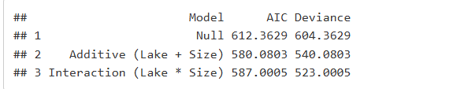
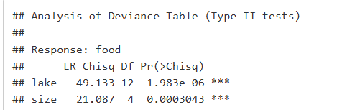

Model Selection & Significance.
The Selection Process.
To identify the most reliable model, we compared three candidates: a Null model, an Additive model (Lake + Size), and an Interaction model (Lake * Size). While the Interaction model showed the lowest raw deviance, the Additive Model achieved the lowest AIC (580.08). This indicates that the dietary shifts associated with an alligator's size remain consistent across all four lakes, allowing for a more parsimonious and stable model for our analysis.
Presentation 2026
Type II Likelihood Ratio Tests were performed to verify the contribution of each predictor. Both Lake (chi^2 = 49.13, p < 0.001) and Size (chi^2 = 21.09, p < 0.001) were found to be highly significant. These results confirm that geographical location and biological maturity are not just correlated with diet, but are primary drivers of food choice in the Florida alligator population .
04

Slide 6
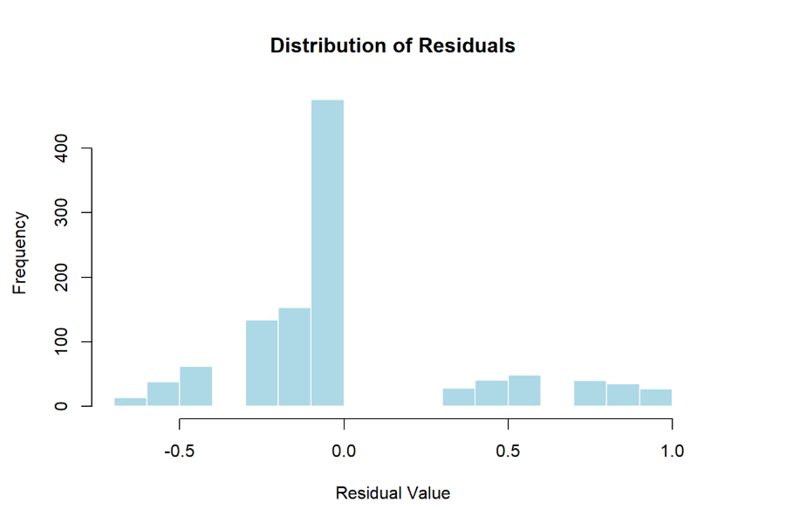
05
01
03
McFadden’s Pseudo-R^2: Our model achieved a value of 0.1064. In multinomial ecological modeling, where individual animal behavior is highly variable, a value above 0.10 indicates that the predictors (Lake and Size) provide a significant and meaningful improvement over the null model.
Residual Analysis: The distribution of response residuals shows a strong central peak at 0.0. This confirms that the model’s predicted probabilities align well with the actual observed choices for the majority of the 219 alligators in the study.
Model Validation
02
04
Classification Accuracy: The model correctly predicts the primary food choice 48.4% of the time. This is more than double the 20% accuracy expected by random chance for a five-category response, proving our predictors are robust ecological indicators .
Addressing Sparsity: While the formal Deviance test suggests a "lack of fit" (p = 0), we conclude this is an artifact of sparse data, specifically the "empty cells" for Birds and Reptiles identified in our EDA, rather than a failure of the model logic.
Presentation 2026

Slide 7
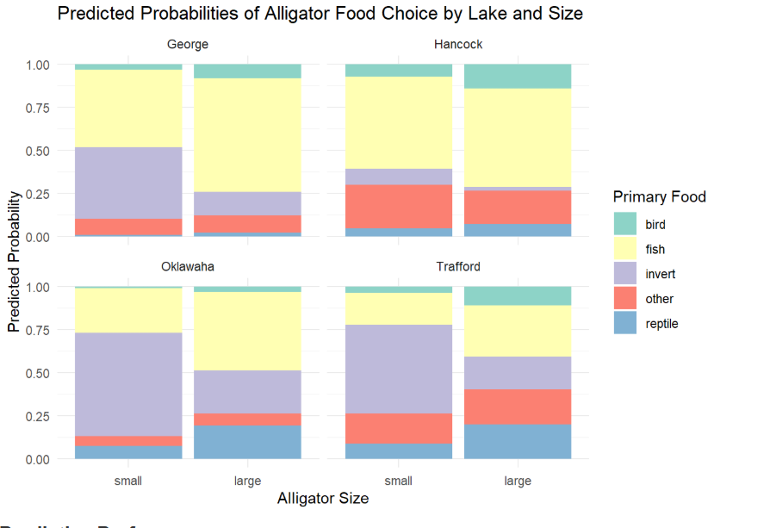
Statistical Interpretation.
The Move Away from Small Prey
By calculating Odds Ratios (OR), we can measure exactly how an alligator's diet shifts as it grows . The most dramatic change is the abandonment of Invertebrates (OR = 0.23). The odds of a large alligator choosing insects or snails over fish are 77% lower than for a small alligator. Put simply, a large alligator is 4.35 times more likely to prefer fish over invertebrates, confirming a definitive shift away from "juvenile" prey as they reach maturity .
Expansion of Diet
While alligators move away from smaller prey, their diet simultaneously expands toward larger vertebrates. Large alligators show 88% higher odds of choosing birds (OR = 1.88) and 42% higher odds of choosing reptiles (OR = 1.42) over fish compared to small alligators. These values confirm that biological maturity acts as a catalyst, allowing the alligator to diversify its diet toward more energy-dense prey as its physical hunting capacity increases.
06

Slide 8
Biological Conclusion
This analysis confirms that alligator dietary habits are not random but are strictly governed by geographical habitat and biological development. Using a multinomial framework, we successfully quantified the shift which is transition from a high-probability invertebrate diet in juveniles to a vertebrate-heavy diet in adults . This transition is statistically significant (p < 0.001) and represents a critical survival strategy for the species.
Model Performance & Final Verdict
While formal tests suggested a "lack of fit" due to sparse data in rare categories, our validation metrics prove the model's practical utility. With a 48.4% classification accuracy and centered residuals, the additive model provides a parsimonious and accurate map of predatory behavior . We conclude that Size and Location are the dual engines driving the predatory lifecycle of the Florida alligator.
07

Slide 9
Thank You
References
Agresti, A. (2019). An Introduction to Categorical Data Analysis (3rd ed.). Wiley.
Florida Game and Fresh Water Fish Commission. Alligator dietary dataset (Table 8.1).
Friendly, M. (2024). vcdExtra: Visualizing Categorical Data Extended. R package version 0.8-5.

